Slide 1
Pong Game
- PyGame

Slide 2
Team Members
Monowar Hossain (20212017010)
Meherab Hossen (202120051010)
Shahriar Alif (20212030010)
Md. Saif Mahmud Khan (20212055010)

Slide 3
Objective
Two paddles that can be controlled by the player using the keyboard.
A ball that bounces back and forth between the paddles and the top and bottom of the screen.
A scoring system that keeps track of how many points each player has scored.
A simple game loop that updates the state of the game and draws the game objects to the screen.

Slide 4
Introduction
Pong is a simple but addictive two-player arcade video game released in 1972. The game is simple but addictive, and can be played by people of all ages. The game is played on a two-dimensional screen. The ball bounces between the two paddles and the top and bottom of the screen. If the ball passes behind a player's paddle, the other player scores a point.

Slide 5
Mechanics
The game is played on a two-dimensional screen, with each player controlling a paddle at the bottom of the screen. The ball bounces between the two paddles and the top and bottom of the screen. If the ball passes behind a player's paddle, the other player scores a point.
Control:
1. [ W, S ] key for moving blue paddle
2. [ UP, DOWN ] key for moving RED paddle

Slide 6
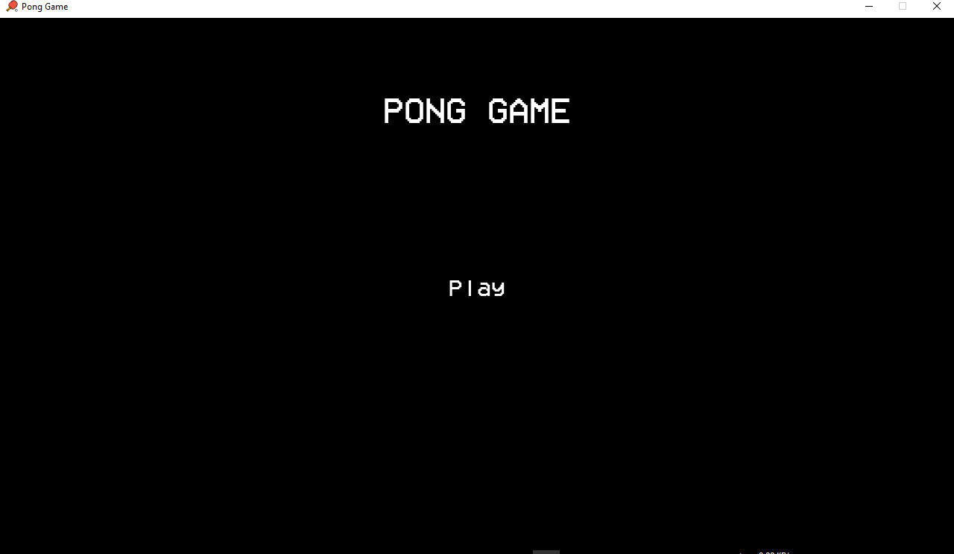
Home Page

Slide 7
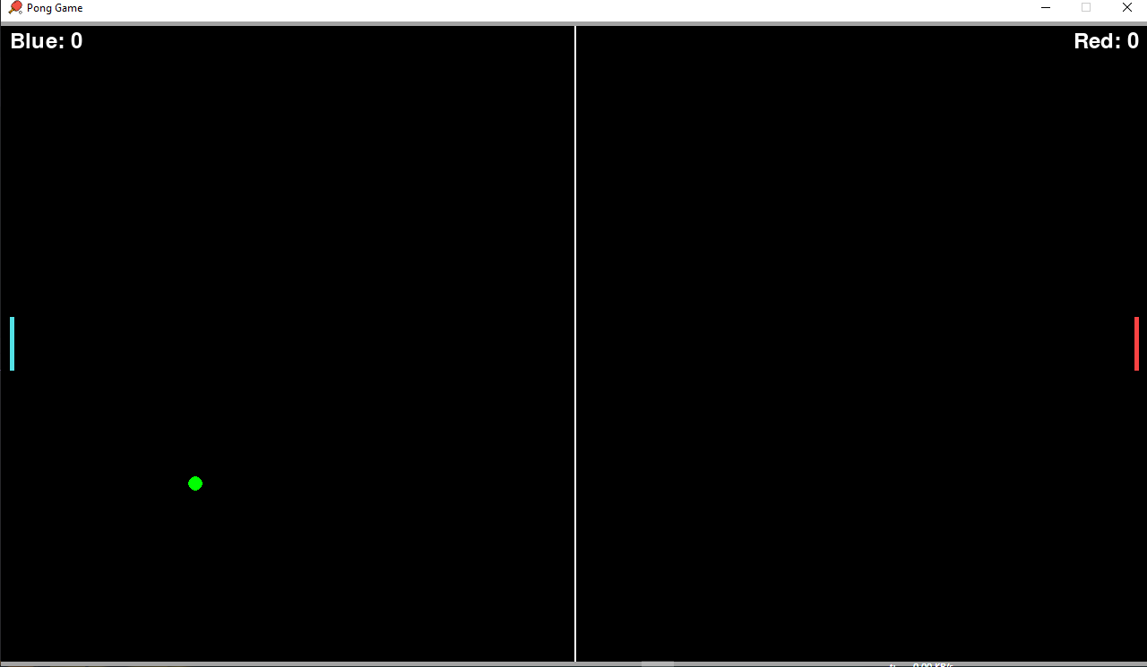
Gameplay

Slide 8
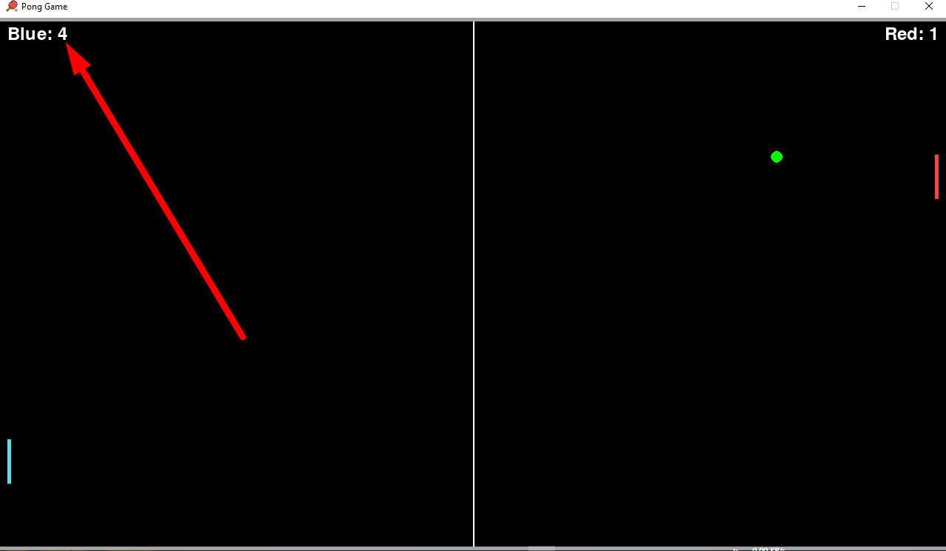
Game Score

Slide 9
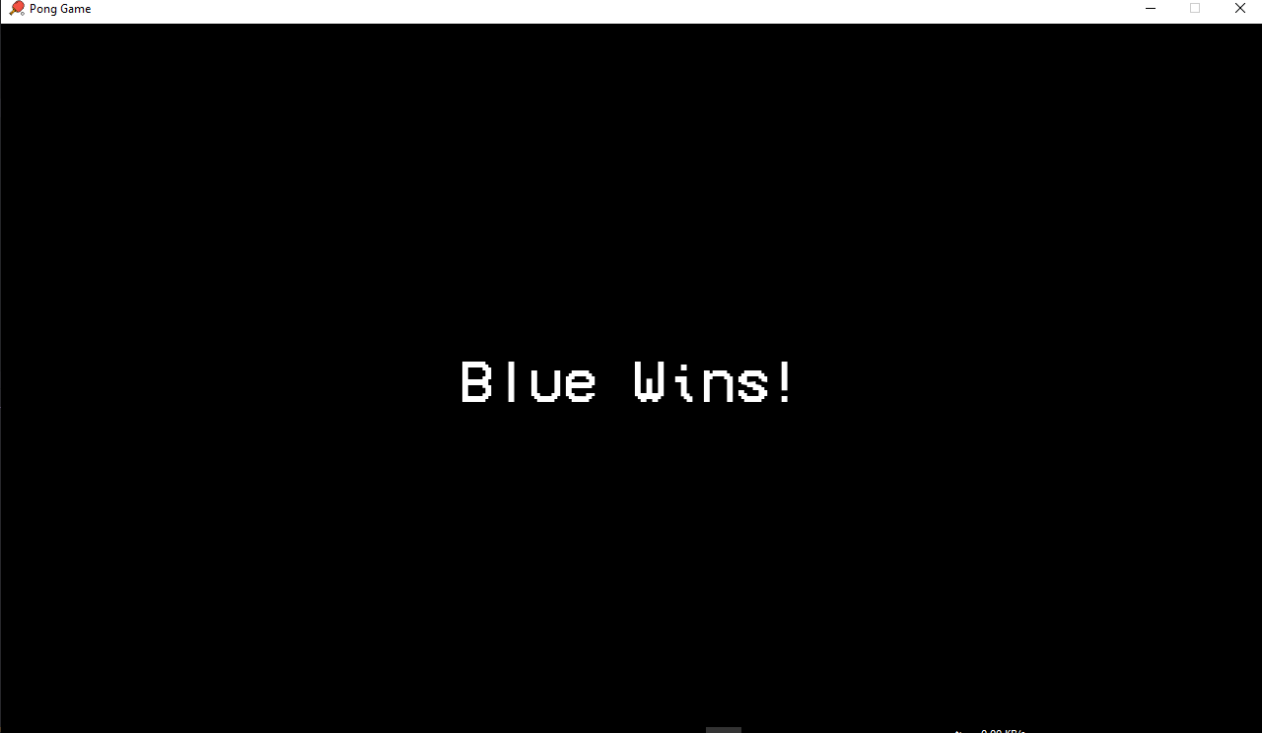
Winner Selection

Slide 10
Features
There are Two colors paddle for identifying players
Thre are some sound effects.
Score Option

Slide 11
E-R Diagram
Start Porgram
Gameplay
Player 1
Winner Selection
If Player Score = 5
Player 2
Winner
Player
Play

Slide 12
Challenges
Predict where your opponent will hit the ball and move your paddle there.
Hit the ball at a difficult angle so your opponent can't hit it back.
Keep your eye on the ball at all times.
Stay focused and don't get distracted.

Slide 13
Future Scope
Here are some specific ideas for future Pong games:
A Pong game with realistic physics and graphics.
A Pong game with online multiplayer support.
A Pong game with a variety of power-ups and game modes.
A Pong game that is used to teach students about physics and game design.

Slide 14
Conclusion
‘PongGame’ is a simple entertaining project that introduces beginners to game development. It offers hands-on opportunity to learn about basic game mechanics, collision detection and user input handelling.
This Porject is a geat starting point for who looking to explore game development with Python and PyGame. Have fun coding and playing you PongGame!

